Slide 1
Hot Fire Attempt 1
March 6th 2018

Slide 2
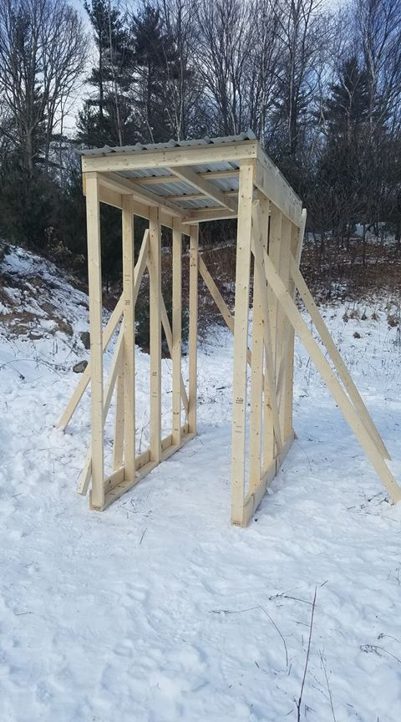
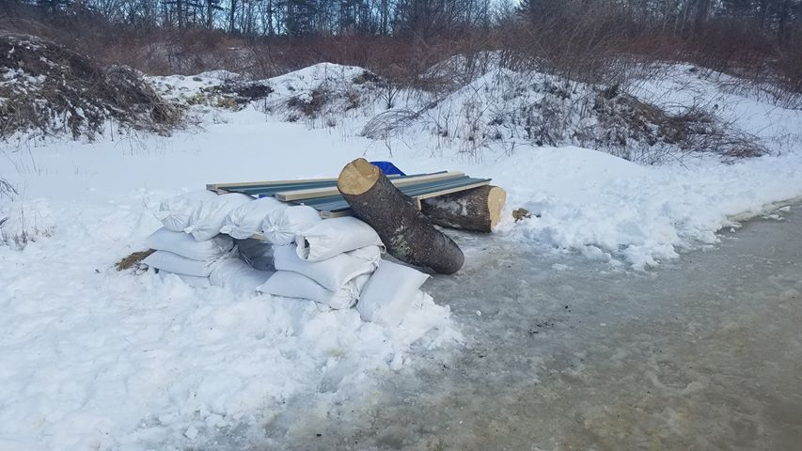

Slide 3
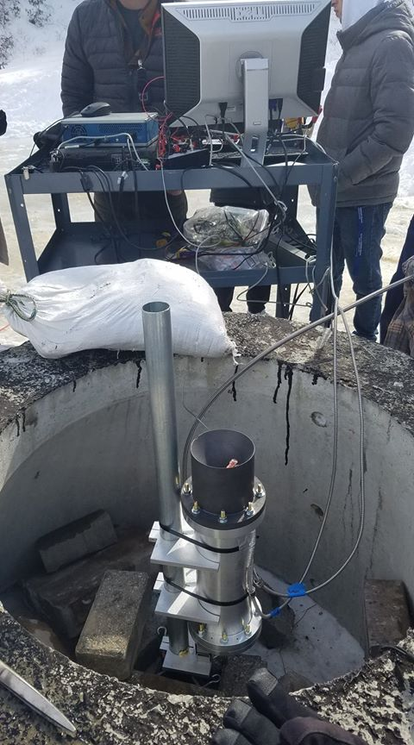
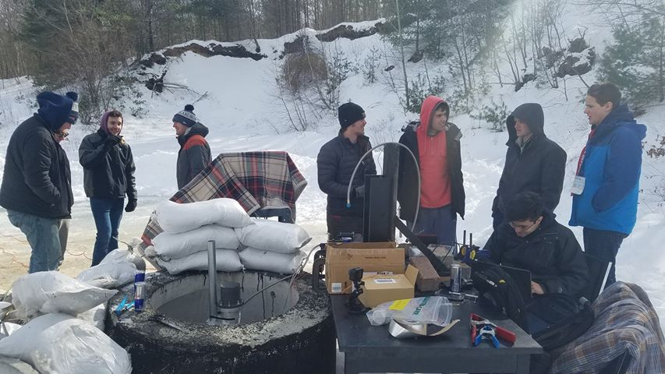

Slide 4
https://www.youtube.com/watch?v=WHUDf3NI4t8

Slide 5
Schedule Today
Hot Fire Update
Blatti Presentation
Horizontal Test Fire Stand
Clean and Redo Room (We have full room now)
Electrical Brainstorm and Spring Break Plan
Mold Research – Redo?
Wednesday we get back – Company presentation hopfully
Next Wednesday, new member info night

